Slide 1

Mentor : Mr. Kartik Muskula
-:Presented by:-
Group No.: 02
Ms. Sana Sultana
Mr. Chinmay Milind Nikumbh
Mr. Amol Shalikram Dongare
Ms. Sweety Rajendra Nandurkar
Mr. PUGALENDHI S
Mr. Rajesh Kumar Sethi
Mr. Rohit Sanjay Gadekar
P-266 RESUME CLASSIFICATION

Slide 2
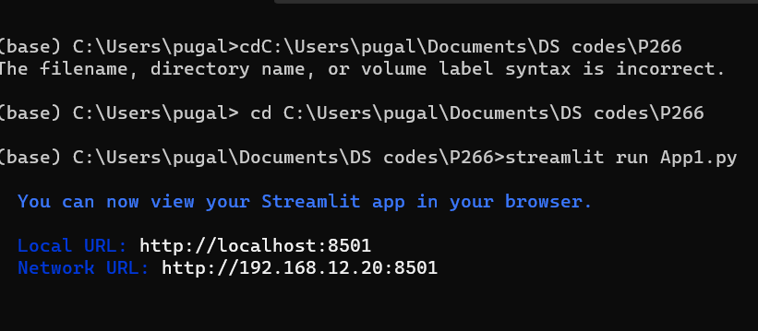
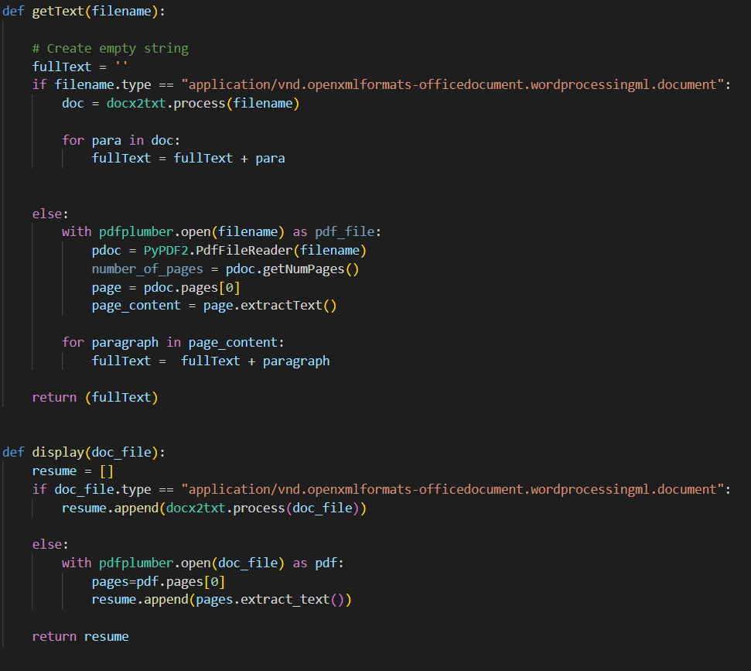
MODEL DEPLOYMENT USING- STREAMLIT
Anaconda prompt
App coding:

Slide 3
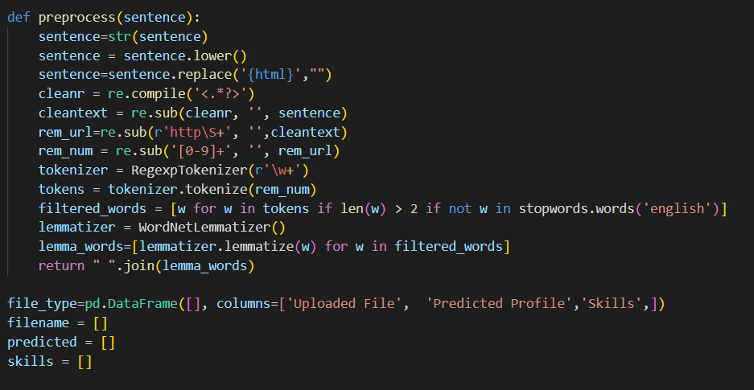
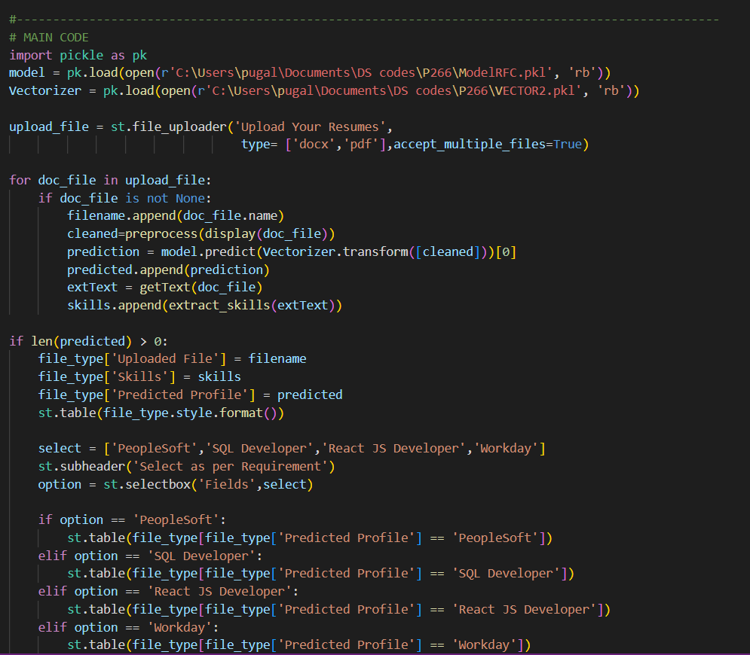
App coding

Slide 4
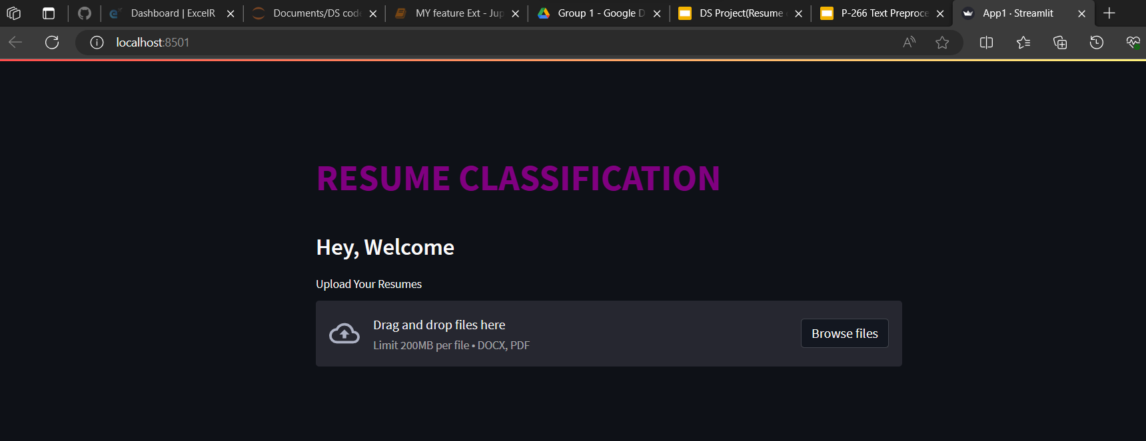
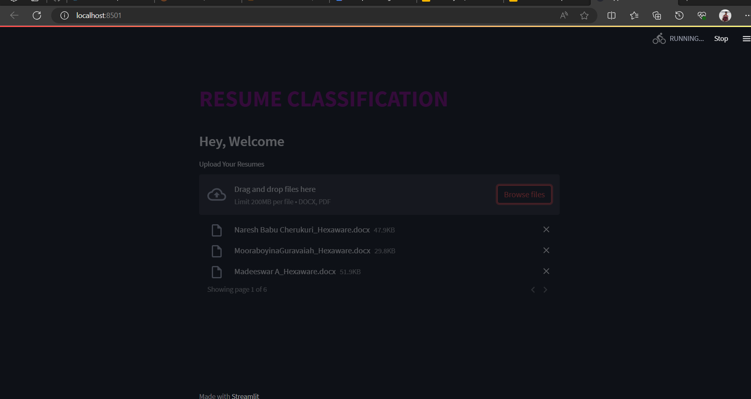
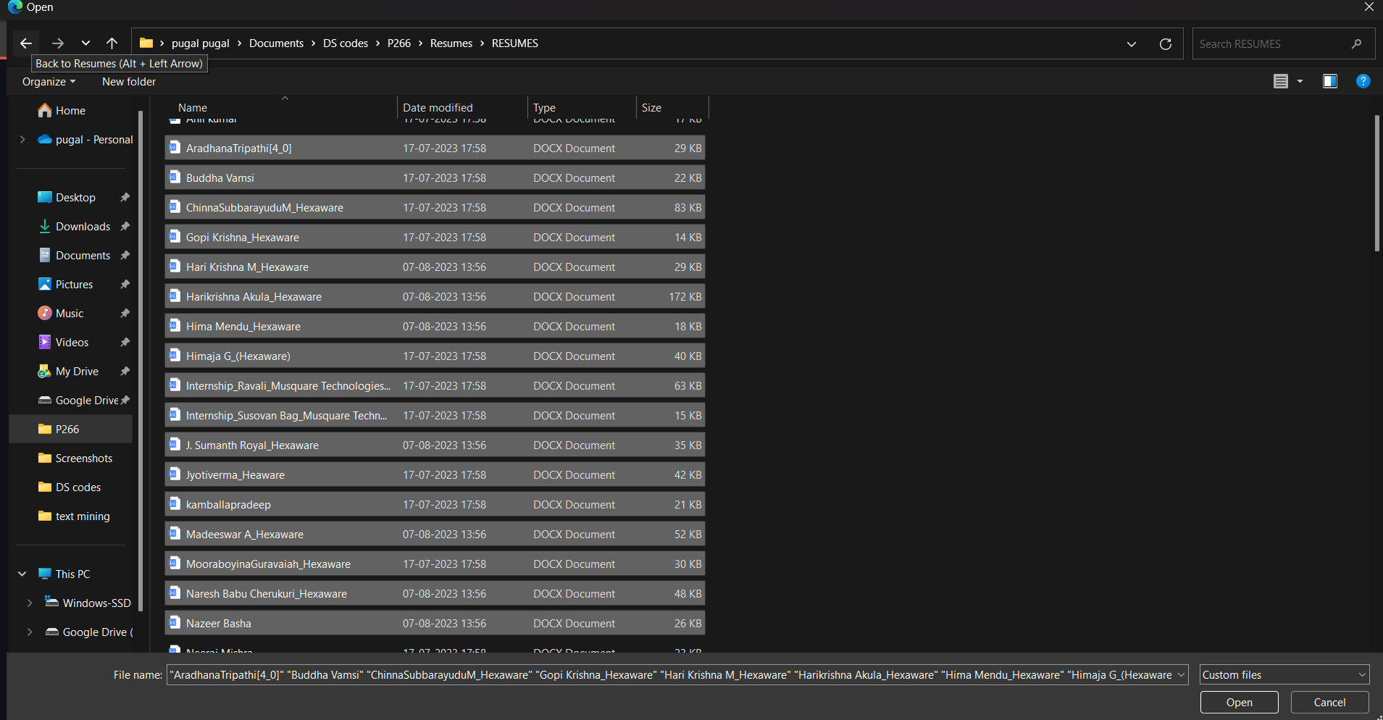
Webapp view
Upload the resumes

Slide 5
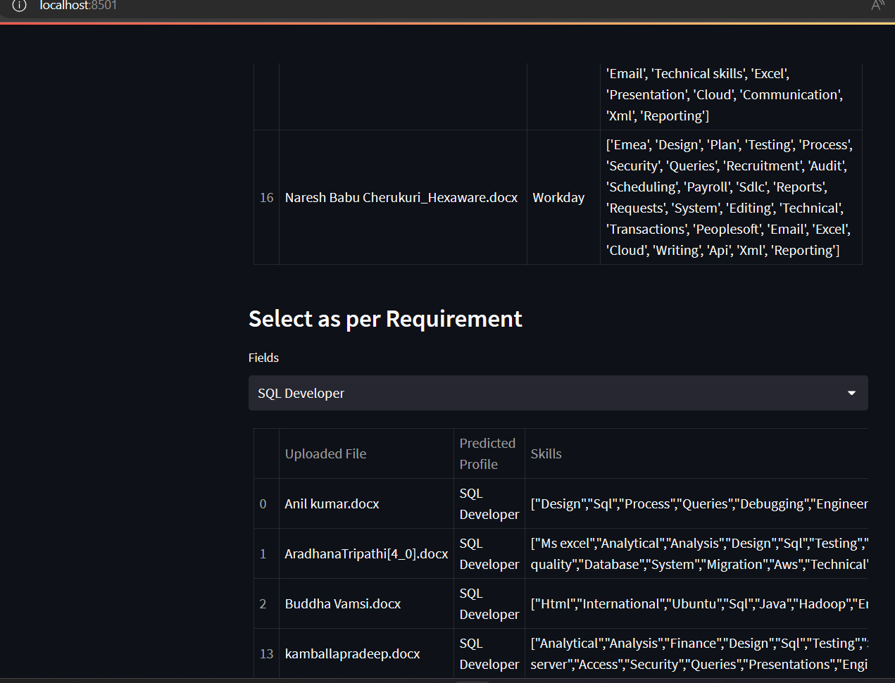
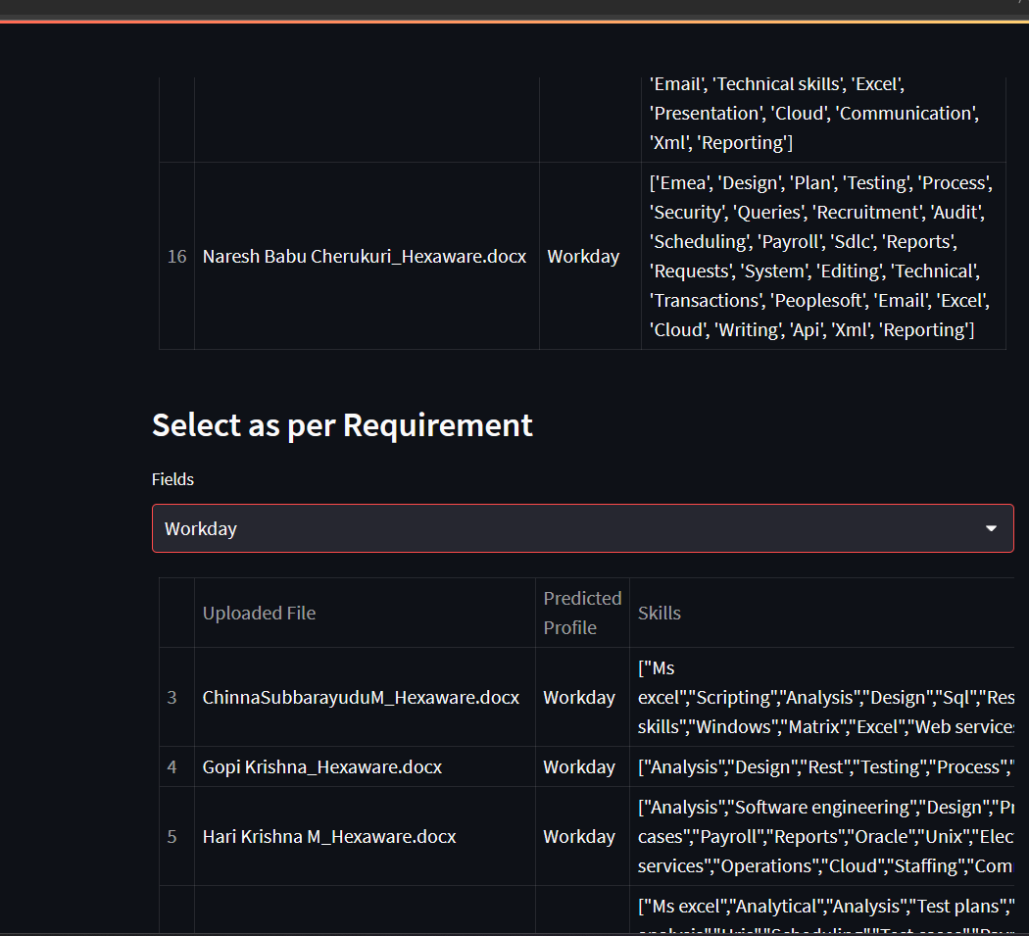
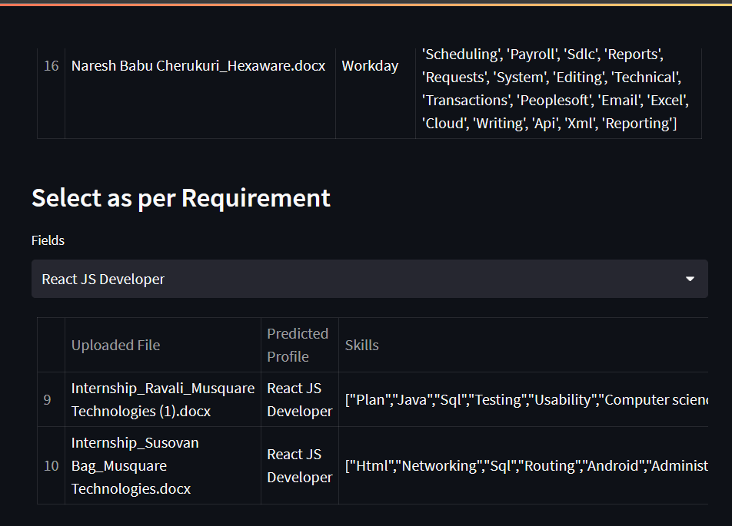
Getting Prediction
SQL Developer
Workday
ReactJS Developer

Slide 6
Problem we faced in deployment
Problem while downloading packages so we locally stored the packages
Problem while installing the spacy and using it so we downgraded the version of spacy
Same issue with the en_core_web_sm
The problem of selection of files while in the deployment is running
Problem of processing the pkl file..

Slide 7
THANK YOU

